Slide 1


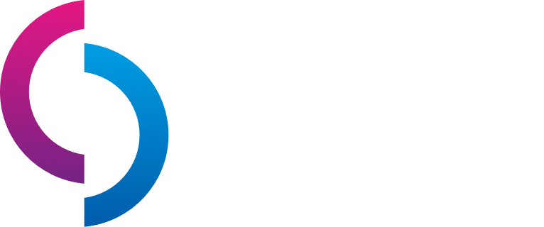

cdc.dev
A Top-Notch tech conference right in the middle of paradise!
@caribbeandevconf

Slide 2






Flow Architectures with Azure Event Hubs
Clemens Vasters
Microsoft Corporation
Chief Messenger
@clemensv
https://github.com/clemensv/messaging

Slide 3
Event-Driven Flow
Observe, Decide, Act, Tell
Imperative Flow
Listen, Obey, Execute, Respond

Slide 4
Imperative
!
👨‍💼
1
2
3
4
👩‍🏭
👷‍♀️
👨‍🔧
👨‍💻

Slide 5
Event-Driven
💡
💡
👨‍💼
🧑‍🔬
👨‍🔧
👷‍♀️
👩‍🏭
👨‍💻
👷‍♂️
💡

Slide 6
Imperative Event-Driven
Execution plan with predetermined actor roles
Work is assigned, executed, and completion reported.
Changes and extensions require modifying the execution plan.
Command & Control
No predetermined execution plan or actors.
Work is volunteered reacting to events and completion is shared
Changes and extensions are local to actors or add/remove actors
Dynamic Collaboration
Most complex systems require both models in different areas

Slide 7
Ticketing Integration Flow
Borussia-Park, Mönchengladbach

Slide 8
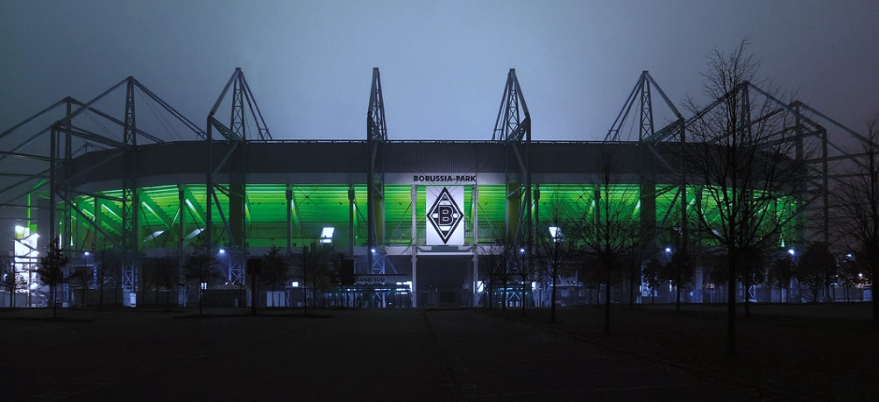
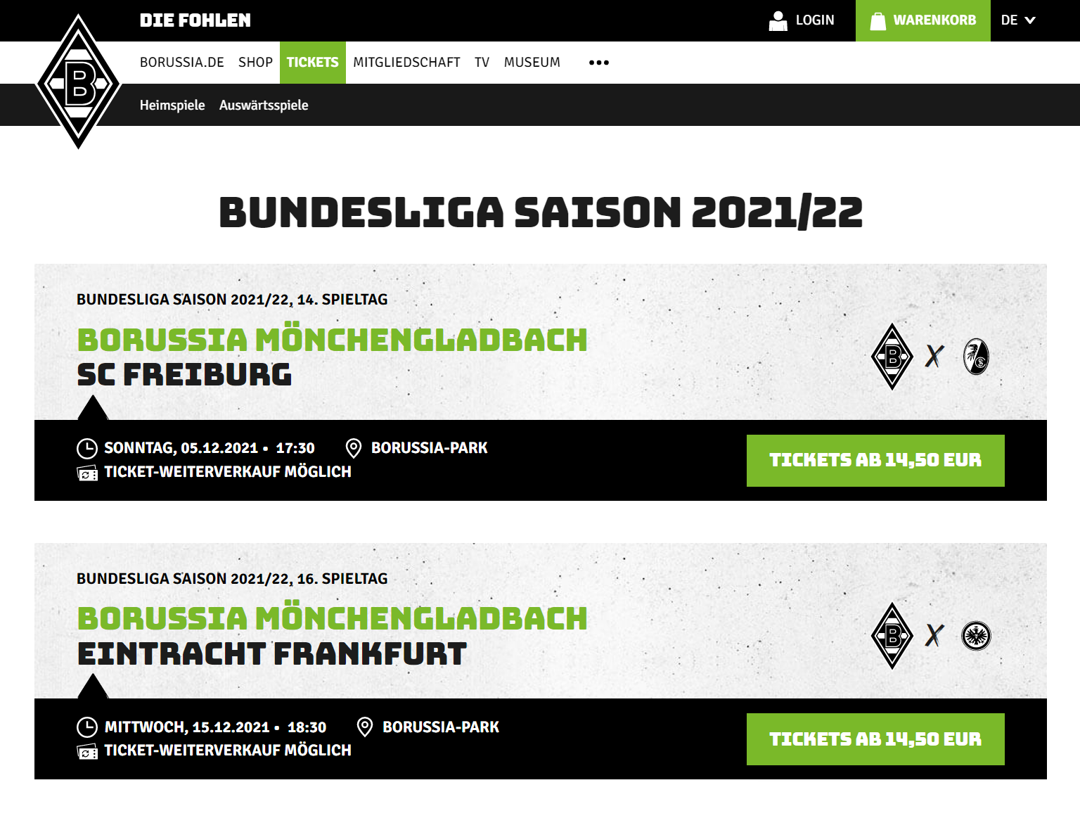
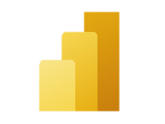

Ticketing Integration Flow
Borussia / EvenTim / AXESS
Automated access control: Axess
Ticket portal: Eventim
ticket codes
ticket sales
customer info
ERP
Live Reporting
customer info
Single-Sign-On Profile

Slide 9
Signals, Streams, and Jobs
Signal: The capture of an occurrence (statement of fact) during the operation of a software system
Event: A data record expressing a signal and its context. The context is expressed in metadata annotating the signal.
Event Stream: A chronological sequence of events belonging to the same context.
Job: Not an event. A description of a task that needs to be performed by some party. Preferably just once.

Slide 10
Signals
Calendar entry created
Meeting scheduled
Inventory item added to shelf
Payment collected
Meeting attendee accepted
Meeting attendee invited
Inventory item added
Calendar appointment reminder
Inventory item removed from shelf
Application deployment initiated
Change committed
Change proposal verification succeeded
Inventory item scanned for sale
Aircraft rotated
Change proposed
Change proposal commented
Mouse cursor moved
Pizza ordered
Application deployment succeeded
Sales lead added
Aircraft position report
Eye focus tracked
Application deployment failed
Vehicle passed induction loop
Pizza prepared
Room humidity read
Advertisement clicked
Delivery address changed
Aircraft squawk code change
CO PPM over threshold
Pizza delivered
Database record inserted
Smoke detected
Virtual machine started
Package scanned
Aircraft landed
Database record updated
Room temperature read
Engine oil pressure read
Stock trade order issued
Package delivered
CPU utilization read
Venue seat ticket reserved
Engine coolant temperature read
Engine RPM read
File changed
Infrared movement detected
Stock trade order executed
Account transfer scheduled
Object detected ahead
Package picked up
Venue seat ticket released
Tank pressure read
File created
Venue seat ticket purchased
Visual object classified
Engine oil pressure threshold alert
Package routed
Stock trade order settled
Account transfer completed
Object velocity differential calculated
Package loaded

Slide 11
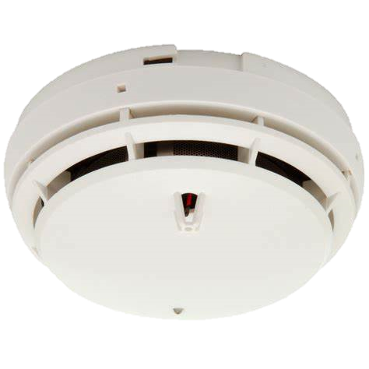
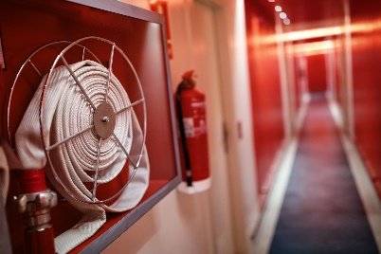
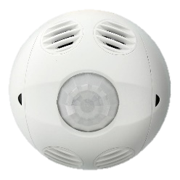
Events: Observations, Signals, Jobs
Signals are immediately actionable
Signal? Job? Is there an expectation to fulfill?
Fire Smoke
Signal
Fire Alarm!
Action(s)
Average crossed threshold
Action(s)
Climate: Temperature Humidity
Derivative signals are computed from sequences of observations
Signal
Observations
Time

Slide 12

Push-style distribution of discrete events to serverless workloads or other messaging infrastructures
Discrete Event Router
Azure Event Grid, AWS Event Bridge, Knative Eventing
Queue Pub/Sub Broker
Pull-style, queue-based transfer of jobs and control via message queues and topics
Azure Service Bus, AWS SQS/SNS, Google PubSub, Apache ActiveMQ, RabbitMQ, IBM MQ
Event Stream Engine
Partitioned, high-volume, tape-drive-style sequential recording and unlimited, pull-style re-reads of event streams.
Azure Event Hubs, AWS Kinesis, Apache Kafka, Apache Pulsar, CNCF Pravega
Event Stream Aggregator
Stateful processing of event streams yielding event streams and discrete events as continuous output
Azure Stream Analytics, AWS Kinesis Analytics,
Apache Samza, Apache Flink, etc.

Slide 13
Event Streams and Time(-liness)

Slide 14
Event Data Value – Securities Markets
Data publishers provide more value by further enriching real-time data.
Data Depth Value
Timeliness Value
In many business contexts, real-time data (milliseconds to seconds after occurrence) is measurably most valuable when fresh.

Slide 15

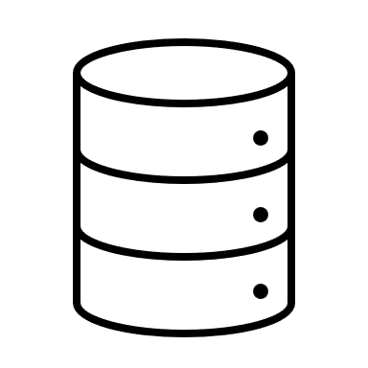

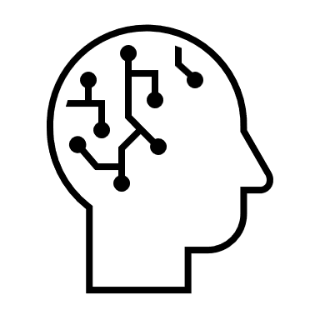





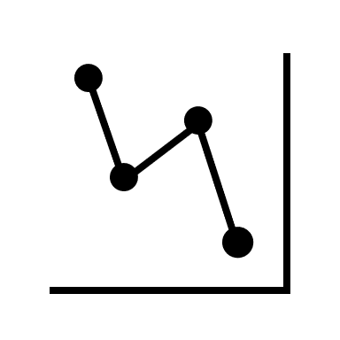
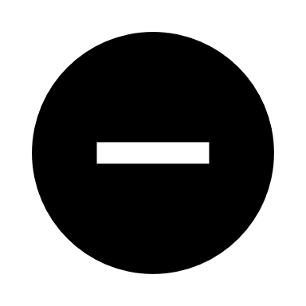

Velocity Matters ➔ Parallelization Matters
Occurrences
Capture
(optional) Shape Enrich, Reduce, Validate, Filter
Disseminate
Analyze, Visualize, React
parallelization
Event data age, processing latency

Slide 16
What is Azure Event Hubs?
Platform-as-a-Service Event Stream Broker
Use the Apache Kafka® API, but with far lower cost and better performance.
Fully managed: You use the features, Azure deals with everything else
AMQP 1.0 standards compliant, Apache Kafka® wire-compatible
Polyglot Azure SDK and cross-platform client support
Industry-leading reliability and availability
Fast.

Slide 17
Azure Event Hubs vs. Apache Kafka®
Similar yet very different
 | Azure Event Hubs | Apache Kafka
User Model | Partitioned event stream broker with high-availability replication | Partitioned event stream broker with high-availability replication
Architecture | Multi-tenant, 3-Tier Gateway/Broker/Storage cluster model, with tenant-isolation, all tiers independently scalable | Single-tenant monolith. Need to increase broker instances in a cluster to scale any dimension.
Implementation Language | C# and Native (C/C++) | Java
Cluster Manager | Azure Service Fabric (inline) | Apache Zookeeper (external); KRaft (inline, experimental)
Partition Mapping | Key hashing, client or server-side mapping of events | Key hashing, client-side mapping of events
Consumer Partition Ownership Coordination | Server-coordinated partition ownership (Kafka), client-coordinated ownership with external leader election. Parallel, direct partition reads. | Server-coordinated partition ownership
Server Workload Balancing | Dynamic and fully automated (100% hands-off). Broker resource allocation independent of partition count or ownership, flexible scaling. | Static assignment of partitions to broker instances requiring operator intervention for rebalancing.
Storage Model | Replicated log store, synchronous per-message flush-to-disk on all replicas | Replicated log store, asynchronous flush-to-disk controlled by host file system write cache settings.
Networking | Single endpoint access to all partitions, Public IP/DNS or Virtual Networking, Firewall. | Endpoint per broker instance. Multiple IPs required. Complex network management required.
Access Control | Token-based access policy model with unlimited publisher policies, Azure Active Directory role-based access control | Local accounts, federation extensibility.
Protocols | AMQP 1.0 (optional: WebSockets) HTTPS 1.1 Apache Kafka RPC | Apache Kafka RPC
Batching / Archives | Avro-packaged batch-packaging and archival to blob store
Schema Registry | Schema Registry based on open CNCF Schema Registry API | (Proprietary from commercial vendors)

Slide 18

Event Hubs
A consumer group is an optional mechanism to allow multiple parallel consumers to coordinate who owns which partition.
Kafka RPC: Broker assigns partitions and checkpoints can be stored in the CG.
AMQP: Clients choose leader using an external mechanism and can break leases using an epoch model. Checkpoints are external. AMQP with server-assigned partitions and CG checkpoints on roadmap.
A log partition is a durable, triple-replicated, append-only storage structure. Each partition has a throughput ceiling imposed by IO and compute limits. More partitions provide more throughput capacity, but also make consumption more complex.
Consumer Group 1
Consumer Group 2
Producers send using a protocol of their choosing, with or without setting a partition key. Partitions can also be targeted directly.
Partition 1
Consumer 1
Consumers on a consumer group own one or more partitions exclusively to ensure in-order processing.
Partition 2
Producer
Event Hub
Consumer 2
Partition 3
Consumers choose the initial log offset: Start (oldest), End (newest), Timestamp, Sequence Number Read progress is noted in checkpoints that can be stored anywhere.
Partition 4
Producers choose their preferred protocol
OASIS AMQP 1.0 Apache Kafka® RPC
HTTPS 1.1
An Event Hub is an event stream manager handling one or more independent log partitions. Different from Apache Kafka®, Event Hubs can optionally assign events to partitions on the server-side.
Consumers choose their own preferred protocol
OASIS AMQP 1.0 Apache Kafka® RPC

Slide 19
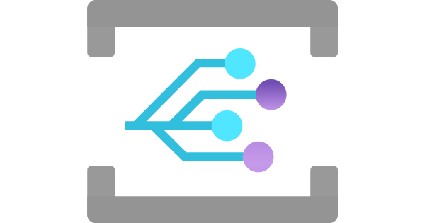
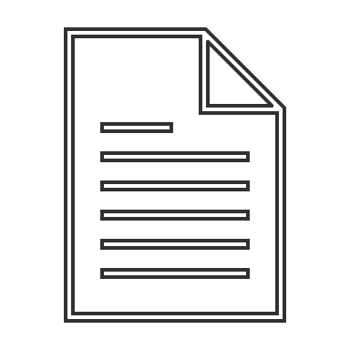
Event Hubs Capture
{Namespace}/{EventHub}/{PartitionId}/{Year}/{Month}/{Day}/{Hour}/{Minute}/{Second}
https://mystorageaccount.blob.core.windows.net/mycontainer/ mynamespace/myeventhub/0/2017/12/08/03/03/17.avro
Event Hubs Capture allows organizing torrents of telemetry in batches that can be easily consumed by batch-oriented analytics frameworks.
Azure Blob Storage
Event is raised when capture file has been written
Lifecycle Policy Automation
Partition 0
Event Hubs Capture Engine
…/myeventhub/0/…
…/myeventhub/1/…
Hot
Partition 1
Producer
Event Hub
…/myeventhub/2/…
Partition 2
…/myeventhub/3/…
Cool
Partition 3
Archived
Producers choose their preferred protocol
OASIS AMQP 1.0 Apache Kafka® RPC
HTTPS 1.1
Expired
Capture throughput keeps up with the Event Hubs' ingress throughput capacity and provides automated low latency capture to batch storage.
Capture policy allows balancing latency and batch size.
Size Limit
Azure Data Lake Gen2
Time Limit

Slide 20
Event Hubs* is not…
* Apache Kafka isn't any of these things, either.
… a publish/subscribe broker. Partitions are not subscriptions. They are chosen by the producer or the broker on ingress. There is also no server-side filtering. → Azure Service Bus, Azure Event Grid
… a queue broker. Read progress over the log is handled by the client and there is no event-level ownership and delivery state handling. → Azure Service Bus
… a discrete event distribution engine. Event Hubs does not do push deliveries, and delivery failures need to be tracked individually. → Azure Event Grid
… a database or long-term event store. Event Hubs exists to catch, store and provide fast access to event data organized around time axis. As data ages (days, not months), you need better indexing. → Azure Cosmos DB, Azure SQL, Azure Synapse, Azure Data Explorer

Slide 21
Event Hubs Namespaces: Virtual Brokers
Public IP
Vnet
A
Vnet
B1
Vnet
B2
DNS
Networking
Event Hubs Platform Host (Event Hubs Dedicated is one host cluster)
Firewall with IP Filters
Firewall
yournamespace [.servicebus.windows.net]
othernamespace [.servicebus.windows.net]
Partitions
orders
1
xyz
2
invoices
3
Consumer Groups
abc
4
deliveries
5
klm
production
6
bmg
Azure Resource Manager

Slide 22
Logical Architecture
Azure Portal
3-tier architecture: Networking, Messaging, Storage
Azure Resource Management API
AMQP 1.0
Apache Kafka RPC
HTTPS / WebSockets
Connection Management
IP Filtering, VNET/PEP
Transport Level Security (TLS)
Authorization Handling
Entity Management
HTTPS / WebSocket Protocol
AMQP 1.0 Protocol
Apache Kafka Protocol
Azure Active Directory
Gateway
AMQP
Partition Placement
Volatile State Replication
Sequencing & Timestamping
Journal Cache
Indexing
Pending request tracking
Checkpoint handling
At-Rest Encryption (CMK)
EH Capture
Premium Units (PU) buy isolated capacity at this layer
Backend (Broker)
(RPC)
HTTPS
Binary Log Data Store
Index Store
At-Rest Data Replication
Storage

Slide 23
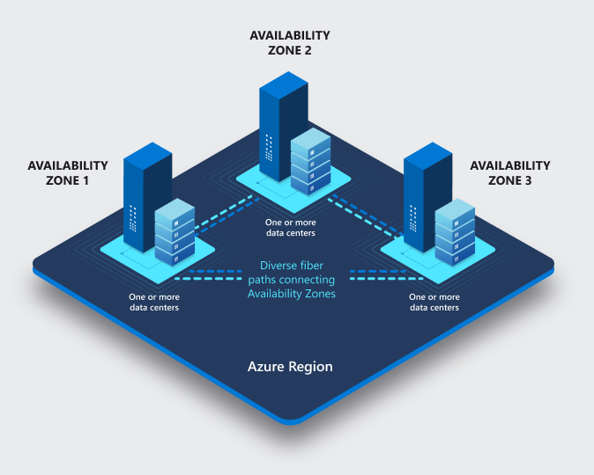
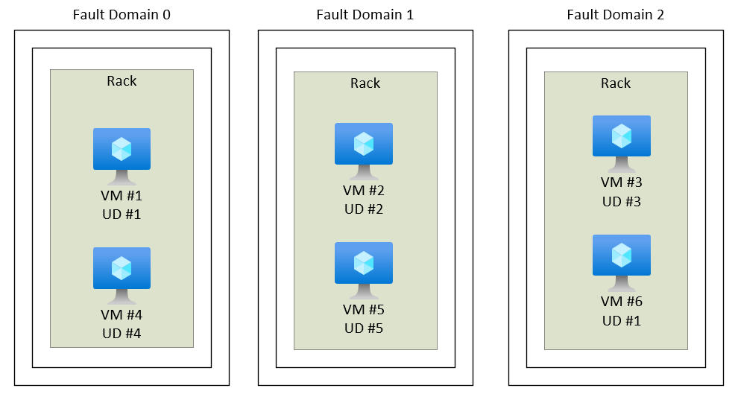
Fault Domains & Availability Zones
High-Availability starts at the physical reality
Fault Domain Placement: Cluster VMs are spread across at least 3 fault domains such that the loss of a rack or network poses no availability risk. Recovery from a fault domain failure is fully automated and the system maintains SLA.
Availability Zones Placement: Each cluster spans three availability zones and maintains SLA without any tolerance for data loss when one or two zones fail.

Slide 24
Backend and Gateway Clusters
Logical Architecture meets Placement
Process Container
Process Container
Process Container
Process Container
Process Container
Process Container
Process Container
Process Container
Process Container
Process Container
Process Container
Process Container
Process Container
Availability Zone 2
Availability Zone 3
Azure Service Fabric (SF) – Leader election (who owns what?), leader lookup, process placement and activation
Availability Zone 1
Fault Domain 1
Fault Domain 2
Fault Domain 3
Fault Domain 1
Fault Domain 2
Fault Domain 3
Fault Domain 1
Fault Domain 2
Fault Domain 3
VM1
VM3
VM5
VM7
VM9
VM11
VM13
VM15
VM17
VM2
VM4
VM6
VM8
VM10
VM12
VM14
VM16
VM18
Azure Virtual Machine Scale Sets (VMSS) – VM Placement/Deployment & Networking (SLB)

Slide 25
Backend and Gateway Clusters
Principles
Everything is automated. There's no manual intervention in placement of VMs or processes or workloads.
Each cluster has a well-known number of virtual machines. We don't use auto-scaling with VMs. We may (rarely) choose to initiate scale up/down to a different level.
Process placement and servicing/upgrade cycles are controlled by Azure Service Fabric.
Allocation of namespaces to clusters are based on well-established heuristics (Standard) or deterministic capacity limits (Premium). Customer-defined allocation in Dedicated.

Slide 26
Gateway and Backend
Azure Portal
Workload placement
Apache Kafka clients only see one broker that owns all partitions. Partition ownership is abstracted.
Azure Resource Management API
AMQP 1.0
Apache Kafka
HTTPS / WebSockets
Gateway
Azure Active Directory
Process Container
Process Container
Process Container
Process Container
Process Container
Process Container
Process Container
AuthZ delegated to AAD
Service Fabric Placement – Stateless Gateway Processes
VM1
VM3
VM5
VM7
VM9
VM11
VM13
VM15
VM17
AMQP
Entities are managed by the gateway layer
Workload placement in the gateway is done by the load balancer (quasi randomly) and accumulated state is managed for the duration of the link lifetime.
The gateway looks up the backend owner of an entity from SF for routing.
P
P
Backend
Process Container
Process Container
Process Container
Process Container
Process Container
Process Container
Process Container
Service Fabric Placement – Stateful Backend Processes
VM2
VM4
VM6
VM8
VM10
VM12
VM14
VM16
VM18
Workload placement in the backend is done by SF leader election, choosing a primary and designated secondary processes for owning a partition. Any required failover from primary to secondary is instant and automatic. Idle entities are unloaded.

Slide 27
Backend: Event Hubs Premium.
Partition ownership is dynamically mapped to the process(es) associated with a namespace via SF
Workload placement
Namespace PU are split across processes: 1 PU = 2 Proc (8GB Mem), 1 Core/Proc (2C)
2 PU = 2 Proc, 1 Core/Proc + 1 Core (3C)
4 PU = 2 Proc, 2 Core/Proc + 1 Core (5C)
8 PU = 4 Proc, 2 Core/Proc + 1 Core (9C)
16 PU = 4 Proc, 4 Core/Proc + 1 Core (17C)
Host 2
Namespace Broker Process 2 (4PU)
P
P
P
P
P
P
P
P
Host 1
Namespace Broker Process 1 (4PU)
P
P
P
P
P
P
P
P
Cores are exclusively mapped to a broker process. >=2PU: 1 Core extra for utility tasks.
CPU Cores L-Series
Memory Allocations
1
2
8GB
VM6
CPU Cores L-Series
Memory Allocations
1
2
+
8GB
Isolated VMs / L88is
VM6
Designated secondaries in different fault domains and AZ reserved for failover
Backend
Process Container
Process Container
Process Container
Process Container
Process Container
Process Container
Process Container
Service Fabric Placement – Stateful Backend Processes
VM2
VM4
VM6
VM8
VM10
VM12
VM14
VM16
VM18

Slide 28
Storage Layer – Event Hubs Standard
P
P
Backend
Process Container
Process Container
Process Container
Process Container
Process Container
Process Container
Process Container
Service Fabric Placement – Stateful Backend Processes
VM2
VM4
VM6
VM8
VM10
VM12
VM14
VM16
VM18
Events are written to append blobs ("extents"). All writes are synchronously triple replicated across availability zones.
Extents are sealed after hitting a size threshold.
Expiry removes extents.
Normalizing / Indexing
Each Event Hub Cluster uses numerous storage accounts to spread the load and overcome storage quota limitations.
Partition storage is allocated to those storage accounts.
Batching
Index
At-Rest Encryption (CMK)
Azure Storage Provider
Storage Account 1 (ZRS)
Stg Acc 2
Stg Acc N
Sealed
Sealed
Active Writes
Extent 1
Extent 2
Extent 3
Partition X Log
B
K
E
T
V
A

Slide 29
Storage Layer – Event Hubs Premium
P
P
Backend
Process Container
Process Container
Process Container
Process Container
Process Container
Process Container
Process Container
Service Fabric Placement – Stateful Backend Processes
Normalizing / Indexing
VM2
VM4
VM6
VM8
VM10
VM12
VM14
VM16
VM18
Batching
Index
Synchronous 3x availability zone replication with flush to disk for each write: Consistently under 3ms.
At-Rest Encryption (CMK)
Block Store Provider
NVMe
NVMe
NVMe
NVMe
NVMe
NVMe
NVMe
rpc
B
B
B
Local Block Store
Process Container
Process Container
Process Container
Process Container
Process Container
Process Container
Process Container
Service Fabric Placement – Stateful Backend Processes
VM2
VM4
VM6
VM8
VM10
VM12
VM14
VM16
VM18
Block store is a fast NVMe based append log store. Native code, Service Fabric Replication.
As with EH Std, Partitions are mapped to accounts.
But only complete extents are written to storage at once.
Storage Account 1 (ZRS)
Stg Acc 2
Stg Acc N
Sealed
Sealed
Active Writes
Extent 1
Extent 2
Extent 1
Extent 2
Extent 3
Partition X Log
B
K
E
T
V
A
Partition X Log

Slide 30
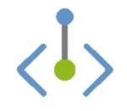
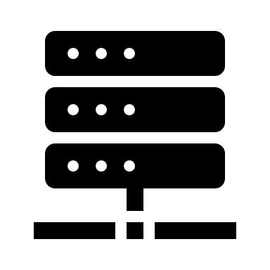
Networking Features
Firewall, Virtual Network Integration with Private Endpoints
Each cluster has a single public load-balancer IPv4 address. The address is generally stable and will very rarely change. But: use DNS firewall rules on your namespace.
AMQP 1.0 w/ TLS
Apache Kafka RPC
HTTPS / WebSockets
CNAME clemensvams.servicebus.windows.net
Namespace names alias the cluster DNS name. EH relies on that hostname to identify the namespace tenant and it can therefore not be further aliased.
Client-Side Firewalls & Proxies
WebSockets AMQP tunneling allows port 443 firewall traversal.
Customer Virtual Network: 10.0.0.0/8
Subnet 1: 10.1.1.0/24
Gateway
ns-eh1-prod-am3-403.cloudapp.net
52.236.186.64
Private Endpoint 10.1.1.42
VM 10.1.1.28
IPv6 SE
TLS 1.2 is the default. All current, supported clients use TLS 1.2 and all traffic generally uses TLS. Legacy clients are still permitted to use TLS <1.2, customer controlled. TLS is terminated at the gateway VMs.
Each cluster has an Azure-private "IPv6 Service Endpoint" address for private endpoints.
Common, namespace-level IP filter and VNet/PEP firewall policy enforcement on each VM.
VM1
VM3
VM5
VM7
VM9
VM11
VM13
VM15
VM17

Slide 31
Networking Features
Event Hubs namespaces can be attached to one or more virtual networks and the public IP address space concurrently and act as safe "Layer 7" stream bridges.
Customer Virtual Network: 10.1.0.0/16
Subnet 1: 10.1.1.0/24
Public Network
Event Hubs Namespace
Customer NAT
Private Endpoint 10.1.1.42
VM 10.1.1.28
Filter
Topic
Client 192.168.1.2
Filter
Customer Virtual Network: 10.2.0.0/16
Subnet 1: 10.2.1.0/24
Private Endpoint 10.2.1.23
VM 10.2.1.56

Slide 32

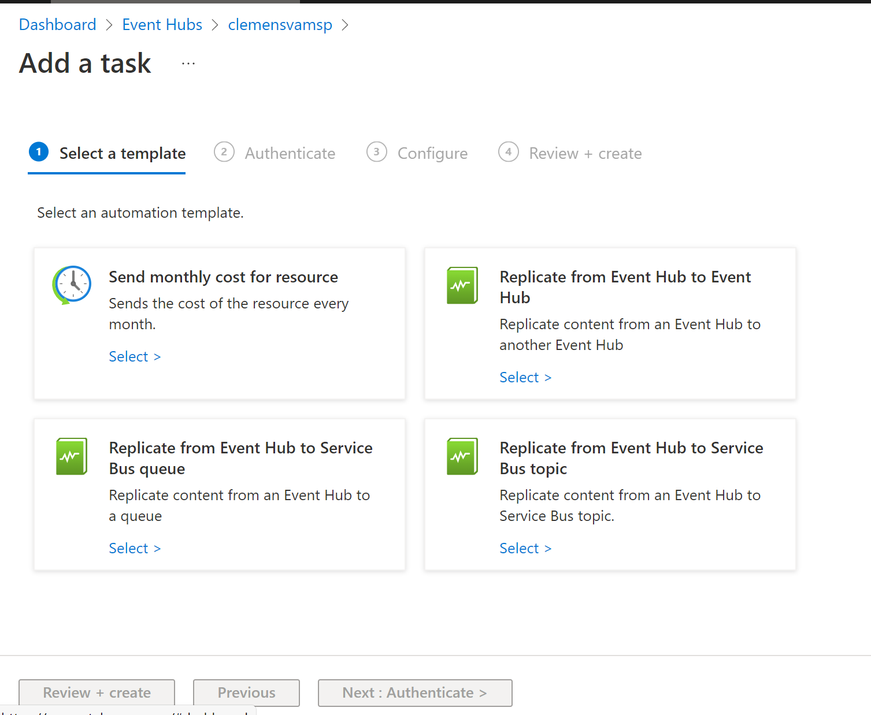

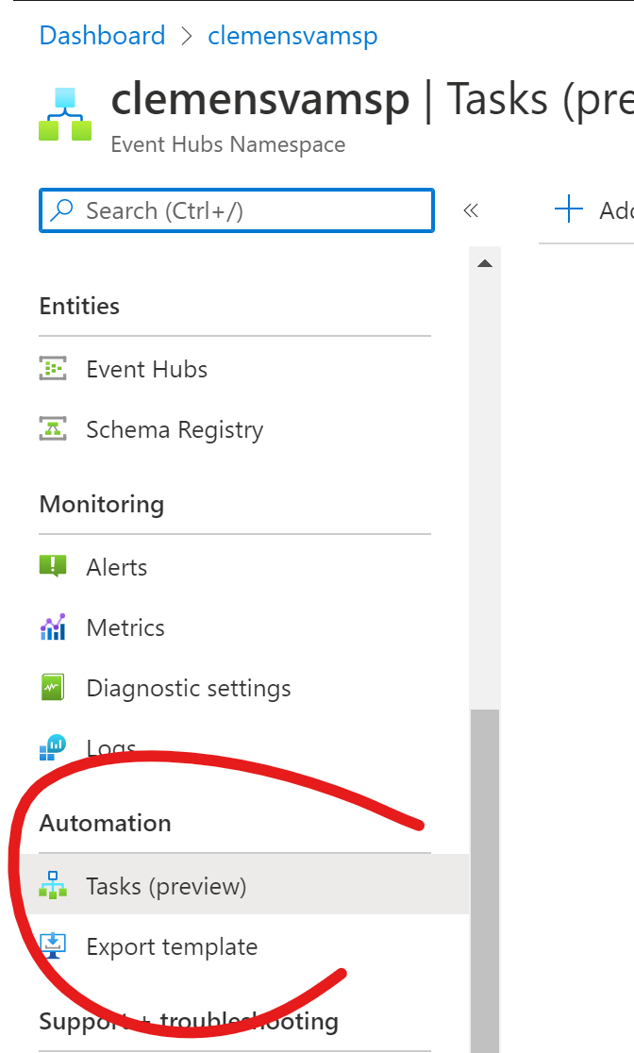


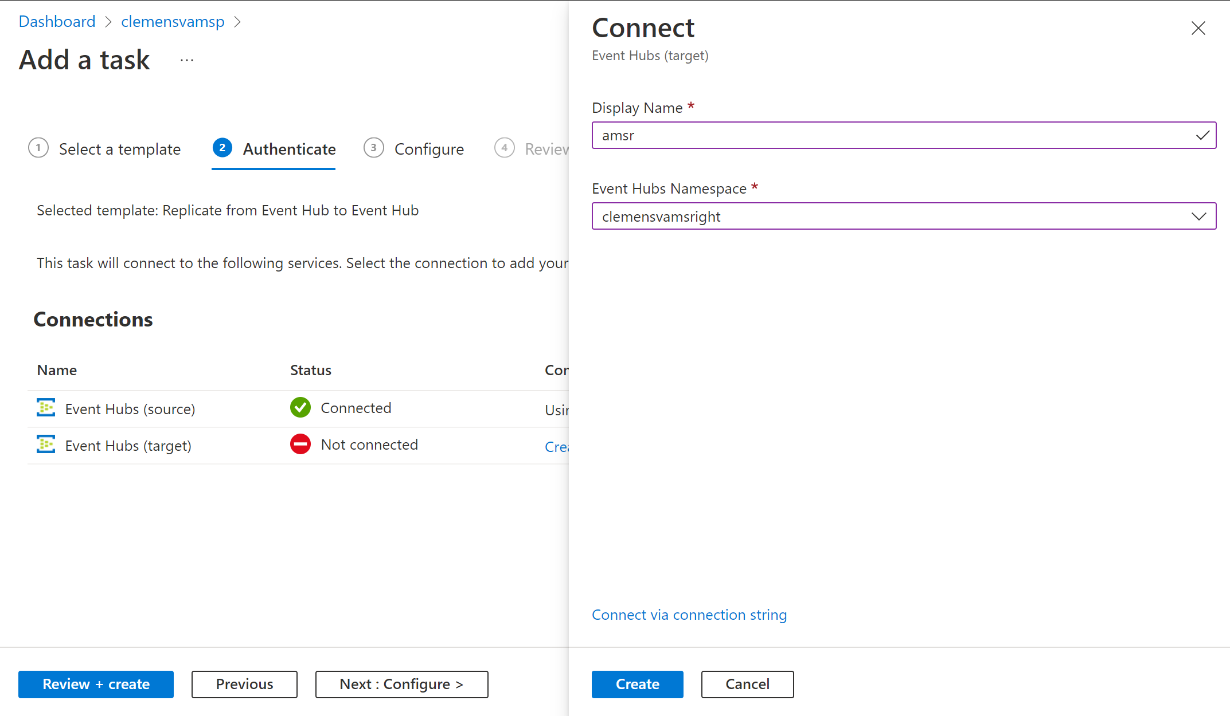
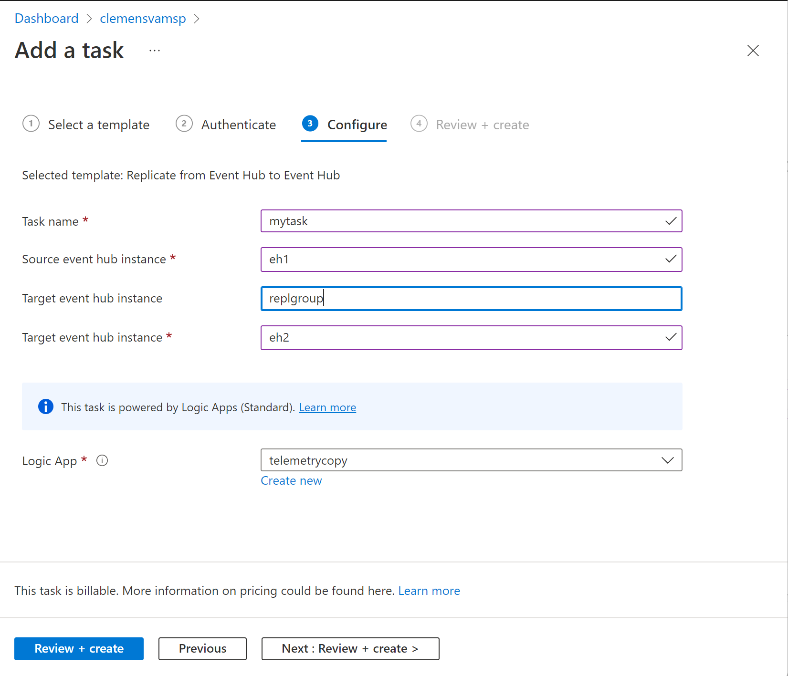
Flows: Automation Tasks
Select template
Create
Establish connection
No-code, no-designer replication backed by Logic Apps (Standard)
Review
Configure

Slide 33
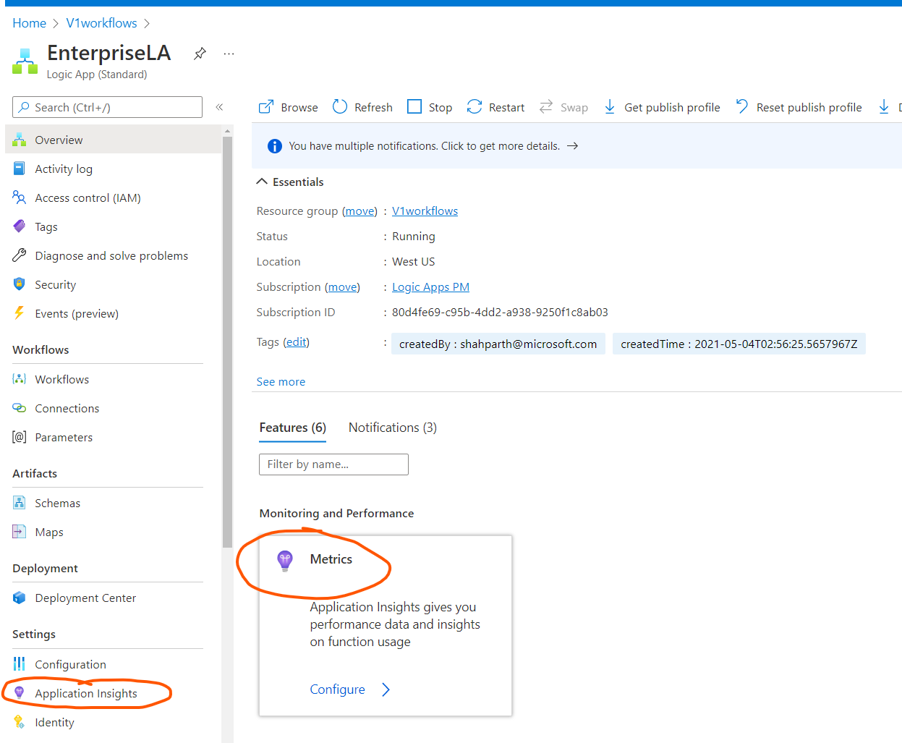
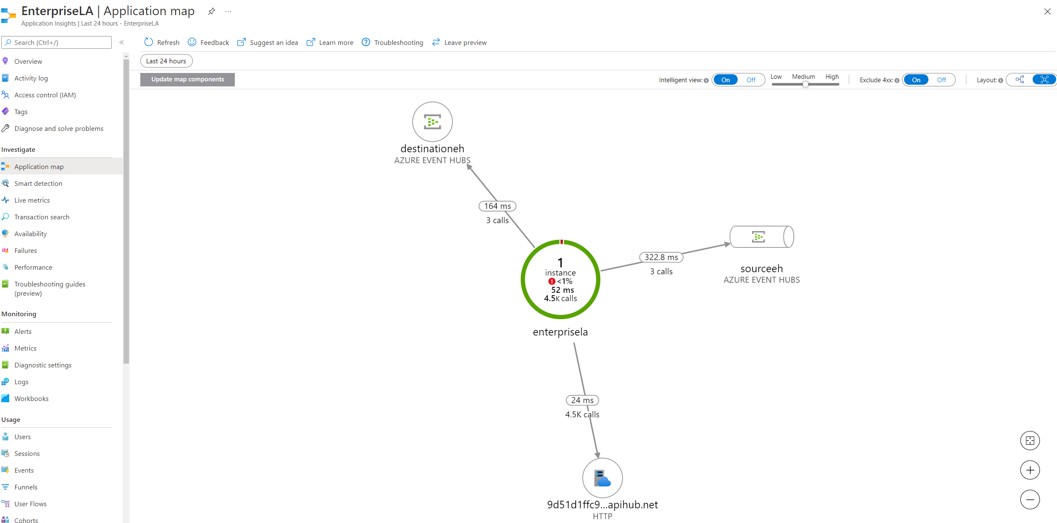
EventHub replication visualization

Slide 34
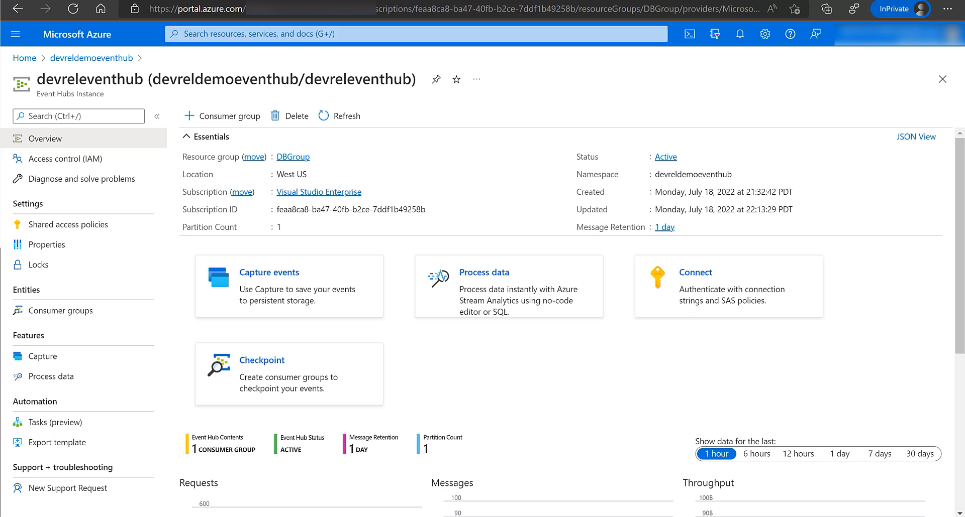

Slide 35
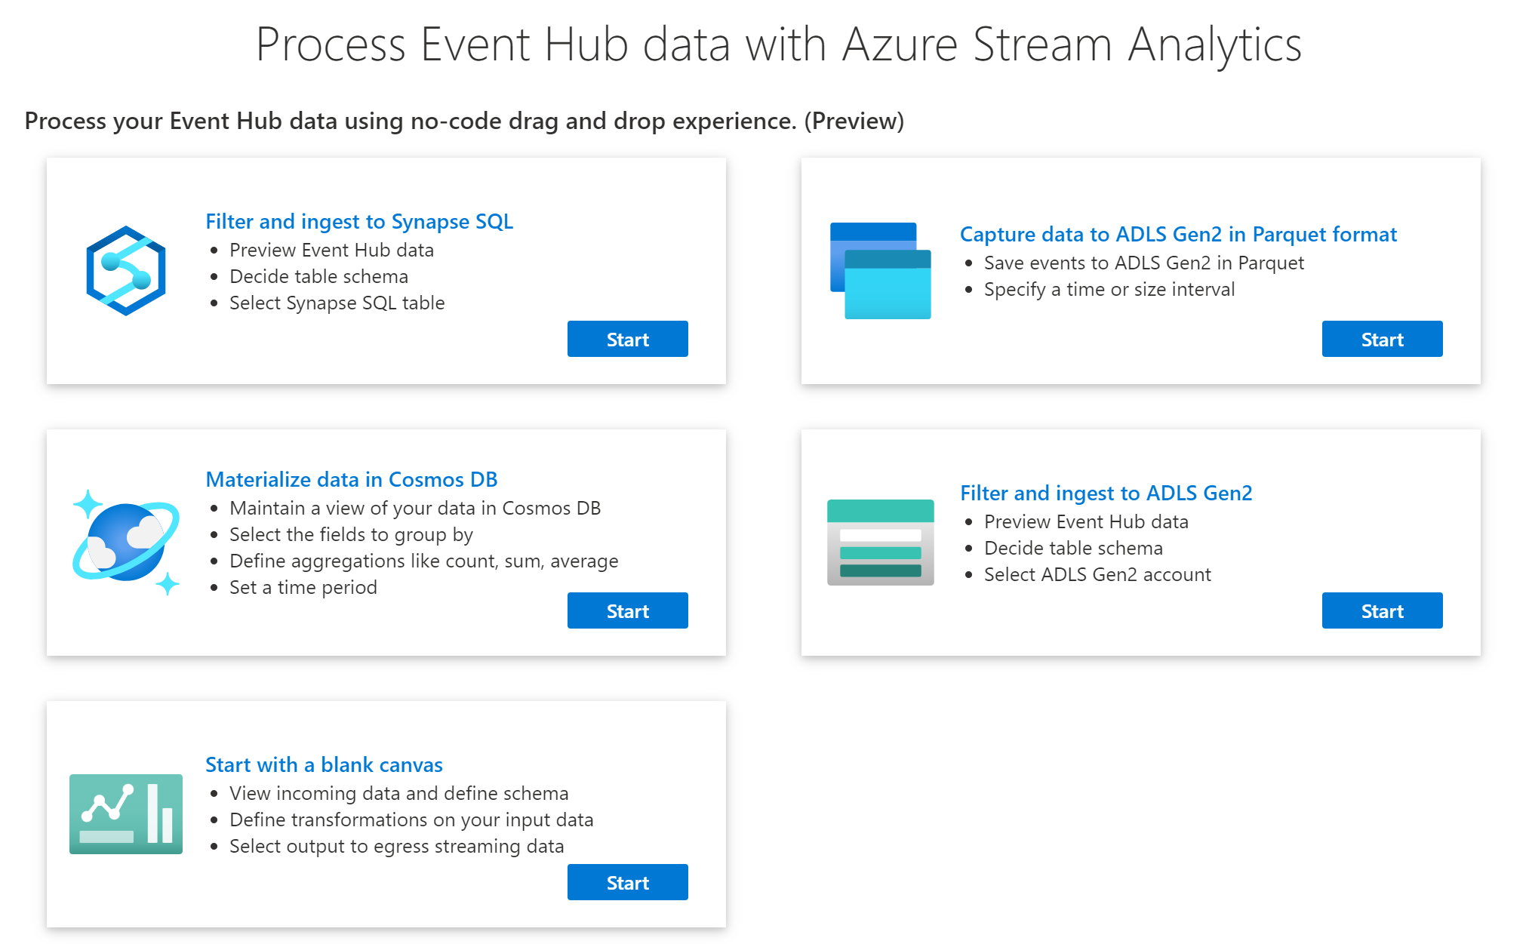

Slide 36
Event Hubs Premium is Fast!
Event Hubs Premium end-to-end latency < 10ms for most Event Streaming workloads.
Performance Metric | Expected Range | Comments
Throughput | ~5-10 MB/s per 1 PU | Maximum throughput can be achieved by scaling partitions For both Kafka and AMQP
Latency | <10 ms | With 1 MB/s load, 4 PU namespace For both Kafka and AMQP

Slide 37
Effective Global Reliability
Uptime – Is the cluster available to accept connections?
100%
Reliability – Are individual operations suceeding?
>99,9999% weekly average

Slide 38
Azure Event Hubs
Platform-as-a-Service Event Stream Broker
Use the Apache Kafka® API, but with far lower cost and better performance.
Fully managed: You use the features, Azure deals with everything else
AMQP 1.0 standards compliant, Apache Kafka® wire-compatible
Polyglot Azure SDK and cross-platform client support
Industry-leading reliability and availability
Fast.

Slide 39
Thank You!

Slide 40
Q&A
That was a lot, wasn't it?

